Slide 1

Advanced Web Technologies Docker
#3
ISEP : DOCKER
Notes:
10 – 15 min
10 – 15 min demonstration
Objective:
Understand concepts/principles
How to use it as a developer
That’s it
Not going to be a Docker expert at the end
Who do you know container/docker .? Able to describe a container/image ?
Who already use Docker ? For what ?

Slide 2
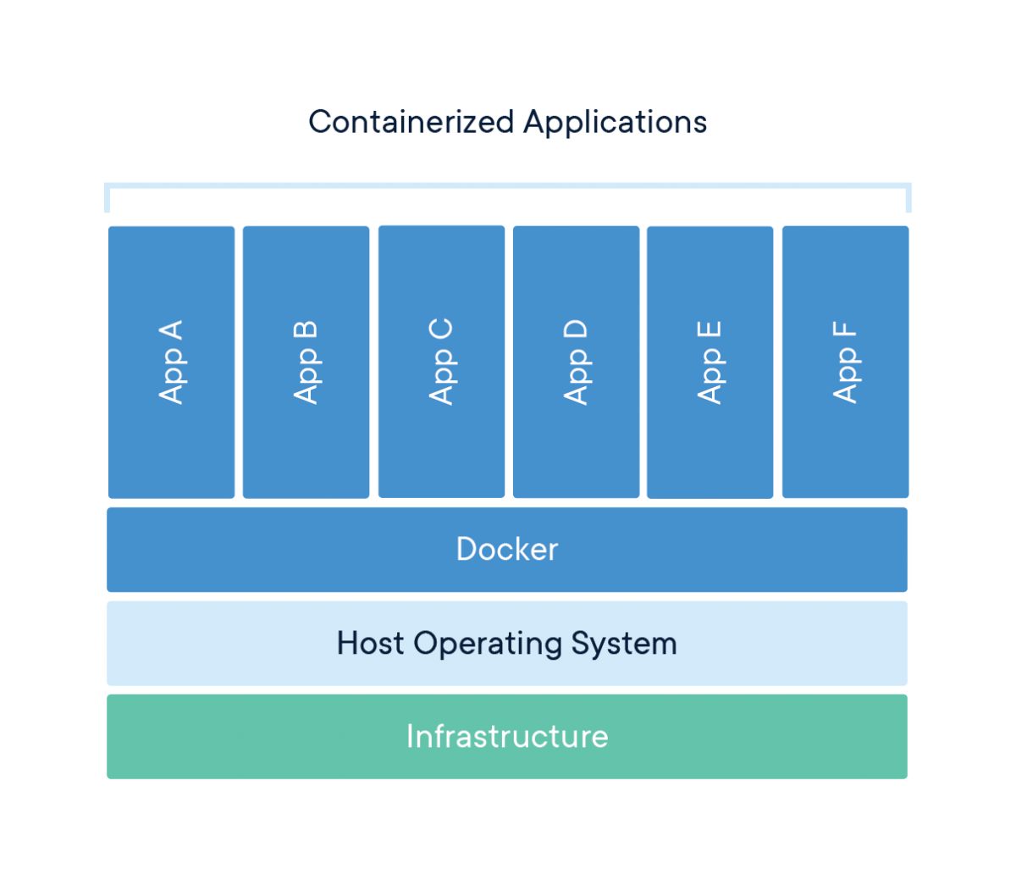
Containers
Isolated workspace
Container is immutable
Container is disposable
Container Engine
ISEP : Docker
Notes:
Isolated workspace :
each application has everything to run on his workspace : a middleware and the application
Container is immutable:
Cannot be modified once created. Really usefull for deployment.
Container is disposable:
- Use them really simple

Slide 3
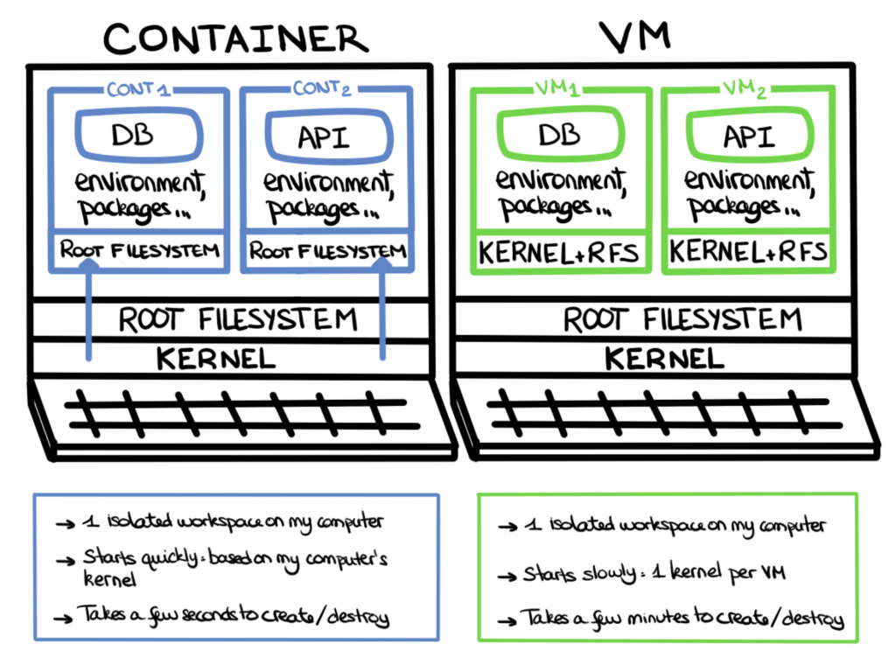
Containers vs VMs
Docker
democratized containerization
most popular one
Main concepts:
Image
Container
ISEP : Docker
Notes:
Image:
is a snapshot of your application, installed with all its dependencies and ready to run
Container:
- This image is then used to build containers, “boxes” in which the code runs. The container can be used and then easily destroyed.

Slide 4
As a developer, why should I use Docker ?
An iso-production dev environment
“A bug? It’s not my fault, it works on my computer!”
A simplification of some of my daily tasks
“It makes onboarding so much quicker!”
“I do not wish to pollute my computer with all the tools I download for my various projects.”
“I do not want to reinvent the wheel”
“POCs don’t frighten me anymore!”
My feedback loop is considerably reduced
“Testing my app is so complicated!”
“It takes so much time to test my app!”
ISEP : Docker

Slide 5
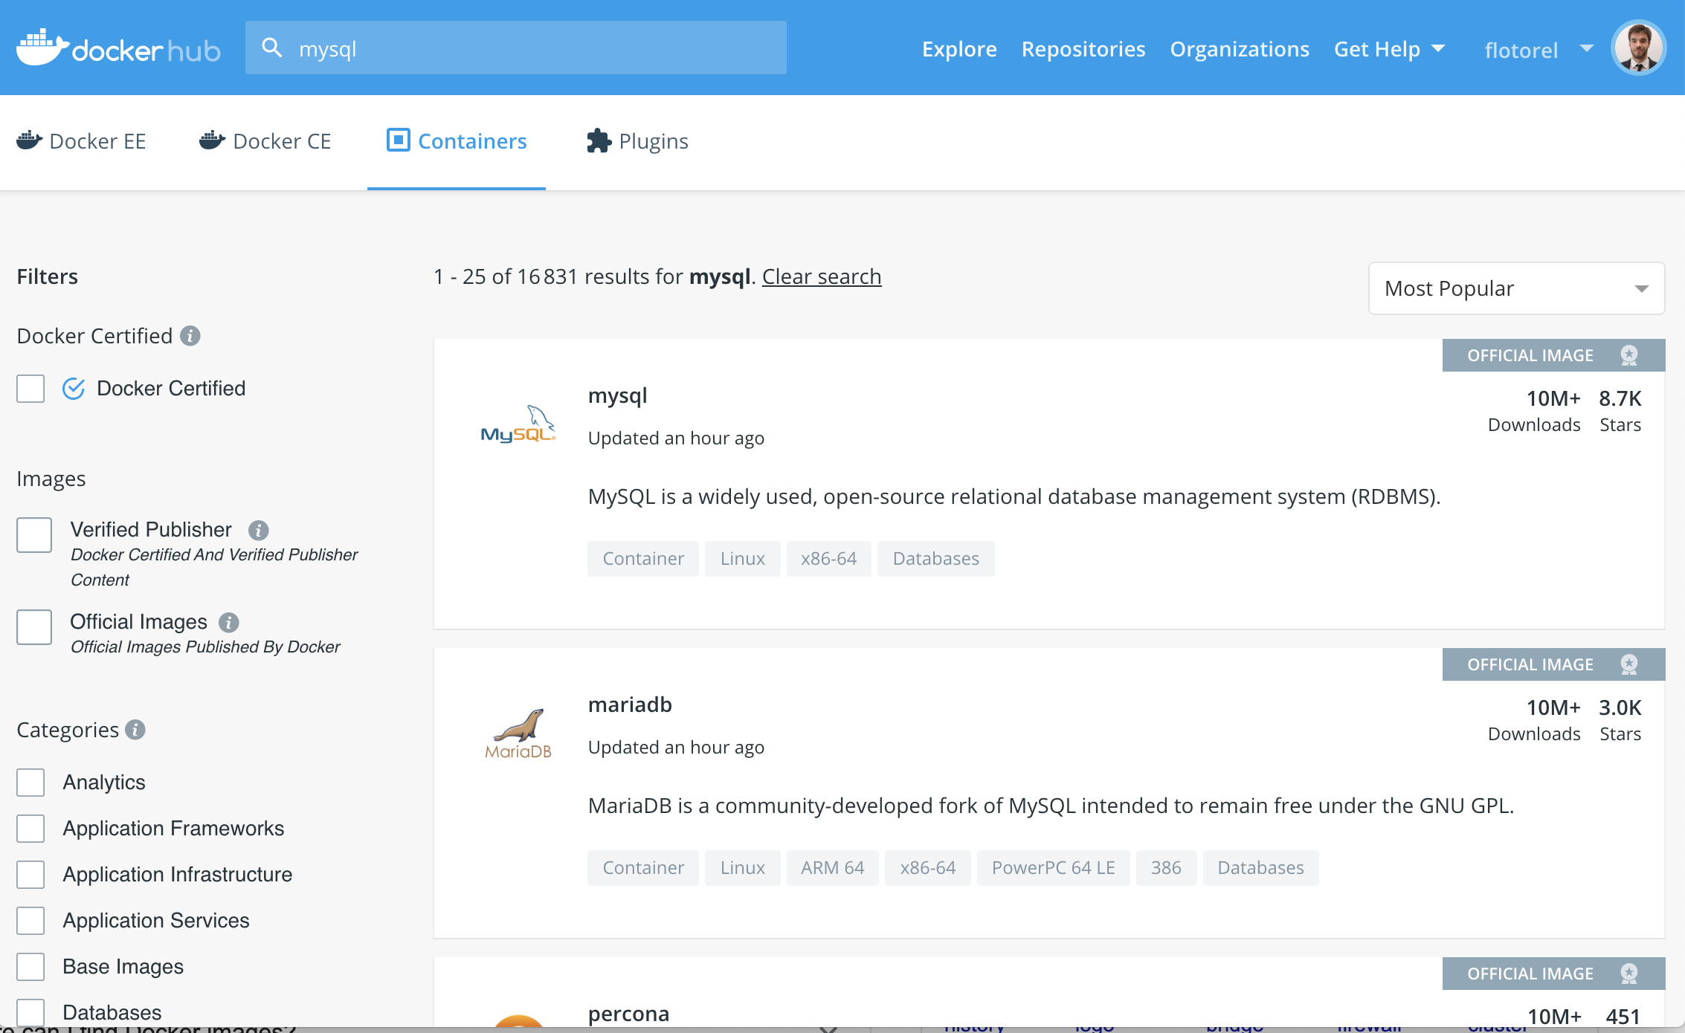
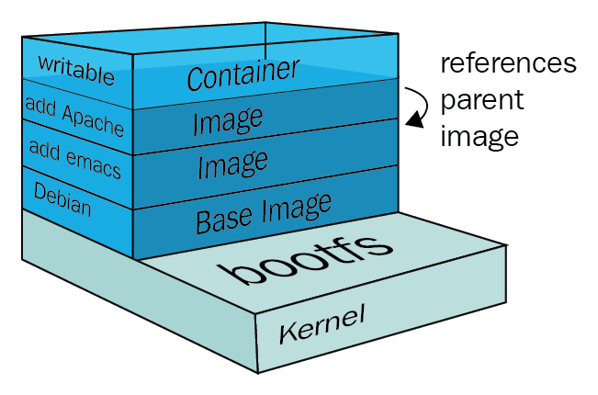
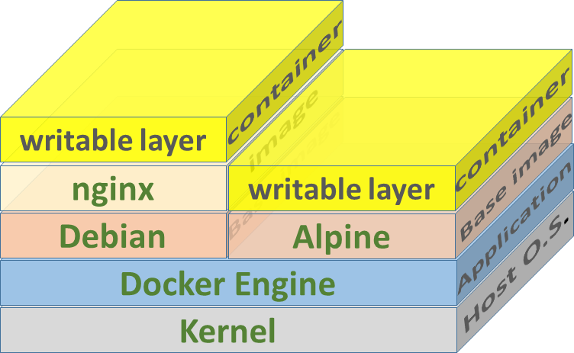

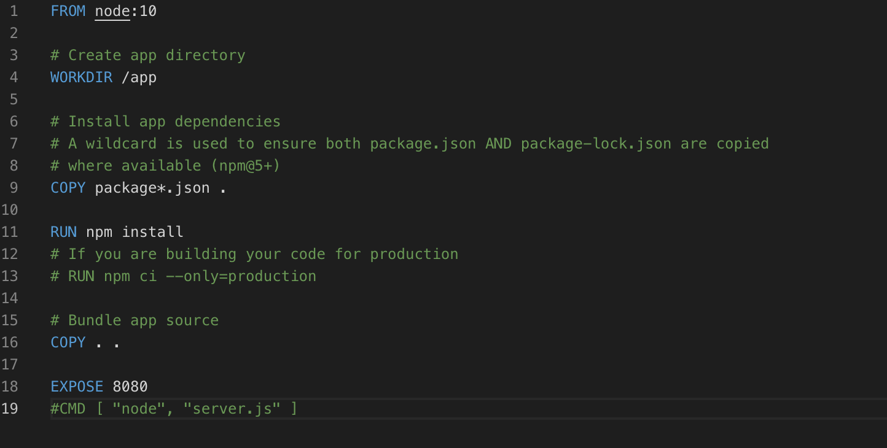
Docker naming and environment
Docker hub
Layering
Dockerfile
ISEP : Docker
Notes:
Layer:
A Docker image consists of several layers
Each layer corresponds to certain instructions in your Dockerfile. The following instructions create a layer: RUN, COPY, ADD. The other instructions will create intermediate layers
Run Image -> container adding a writable layer where you can do whatever you want
Whenever you run a docker container, it is really just using the locally- cached docker image (which is a stack of layers), and creating a new layer on top that is a read/write layer. All of the execution and changes that occur during the running of a container are stored in its own read/write layer.

Slide 6
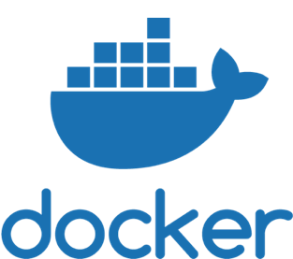

Coding
ISEP : Docker

Slide 7
Docker command line
Useful commands:
docker run [image-name]:[tag]
Run container based on his name and tag
docker run [image-name] –d –p 8080:8080 –e KEY=‘VALUE’
“-d” detached container from the main process
“-p” link container port with yours
“-e” add environment variable
docker run [image-name] –v /my/own/datadir:/container/dir
“-v” link container
docker exec -it [image-name] bash
Enter in running container using the bash processus
ISEP : Docker

Slide 8
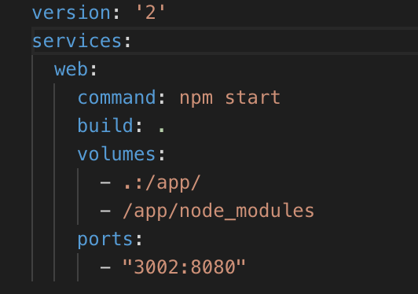
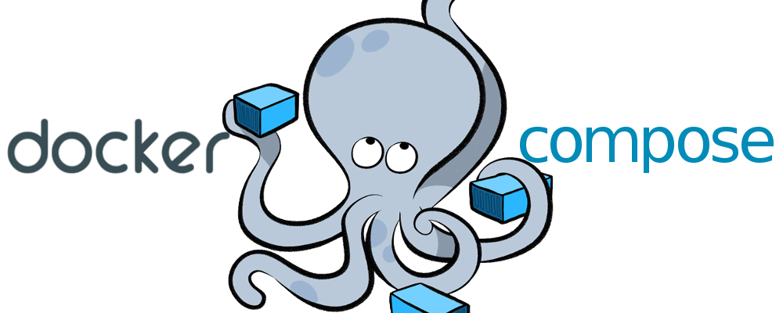
Docker Compose
Useful commands:
docker-compose up -d
ISEP : Docker

Slide 9

That’s finally it! Have fun ☺
#3
ISEP : Docker

